Slide 1

Training Surgeons with Machine Learning
Presented by:
Brendon Mustachio, Junior, Major in Computer Engineering
Selvin White, Sophomore, Major in Computer Science, IT intern
To applying machine learning to medical technology so surgeons can act fast and acquire useful information while they remain in control of a patient’s care.

Slide 2

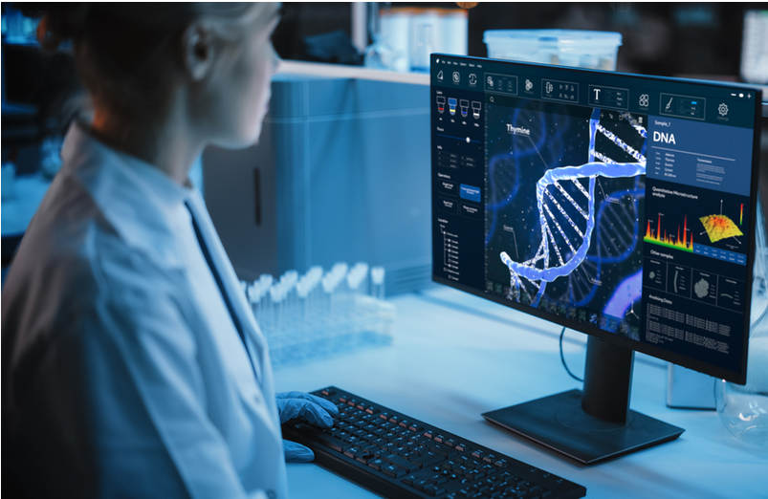
Problem
Can ML models train surgeons efficiently and effectively?
The application of machine learning in the medical field has made it easier for medical professionals to identify diseases and afflictions.
ML helps to detect diseases earlier by examining X-ray and MRIs.
Introduce an advanced model capable of processing live camera feed to reduces noise and sharpens contrast.
Machine learning helps young surgeons perform better and increases their competence in an actual live surgery.
Provide exact precision with surgical tools, reducing risk of accidental damage.

Slide 3
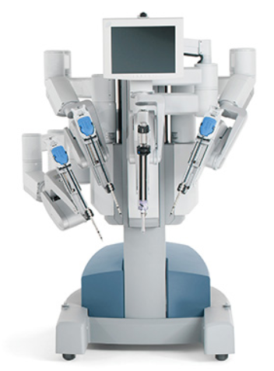

Solution
Our proposed machine learning system would support the surgeon by analyzing recorded robotic motion data and identifying surgical gestures during training tasks.
Tools:
Cameras
Motion Simulator
Python + OpenCV + TensorFlow/PyTorch
Create a model capable of taking live motion data and providing timely feedback on technique
Example:
The Da Vinci surgery robot → → →
Surgeon-controlled robotic platform
Provides precise instrument movement
Minimally invasive access
Proposed ML Workflow Plan
Recorded da Vinci motion Data
Data Preprocessing
ML Gesture recognition models
Real time feedback for training

Slide 4
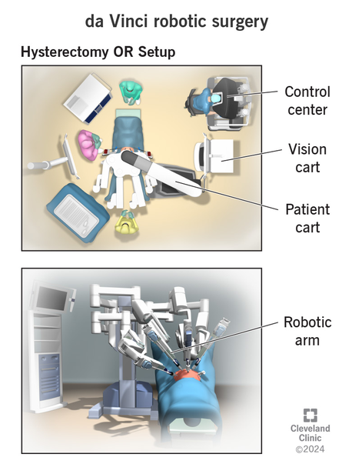
Evaluation
Use recorded Da Vinci surgical training motion data, including task such as suturing, knot tying, and needle passing.
Compare a simple baseline model with temporal machine learning models.
Measure gesture recognition accuracy and use a confusion matrix to identify commonly confused gestures.
Measure the average latency, throughput, memory use, and model size to determine whether the system could support real time training feedback.
Each configuration will run at least 3 times and will be reporting the averages and standard deviation.
Expect a larger model to be more accurate while a smaller model may give a better balance of accuracy, response time, and memory usage.

Slide 5

Feedback and Discussion
Sources:
https://demigos.com/blog-post/machine-learning-in-the-medical-field-cases-challenges/
https://pmc.ncbi.nlm.nih.gov/articles/PMC8822225/
https://cirl.lcsr.jhu.edu/research/hmm/datasets/jigsaws_release/?utm_source=chatgpt.com
https://www.uchealth.com/services/robotic-surgery/patient-information/davinci-surgical-system/

